Slide 1
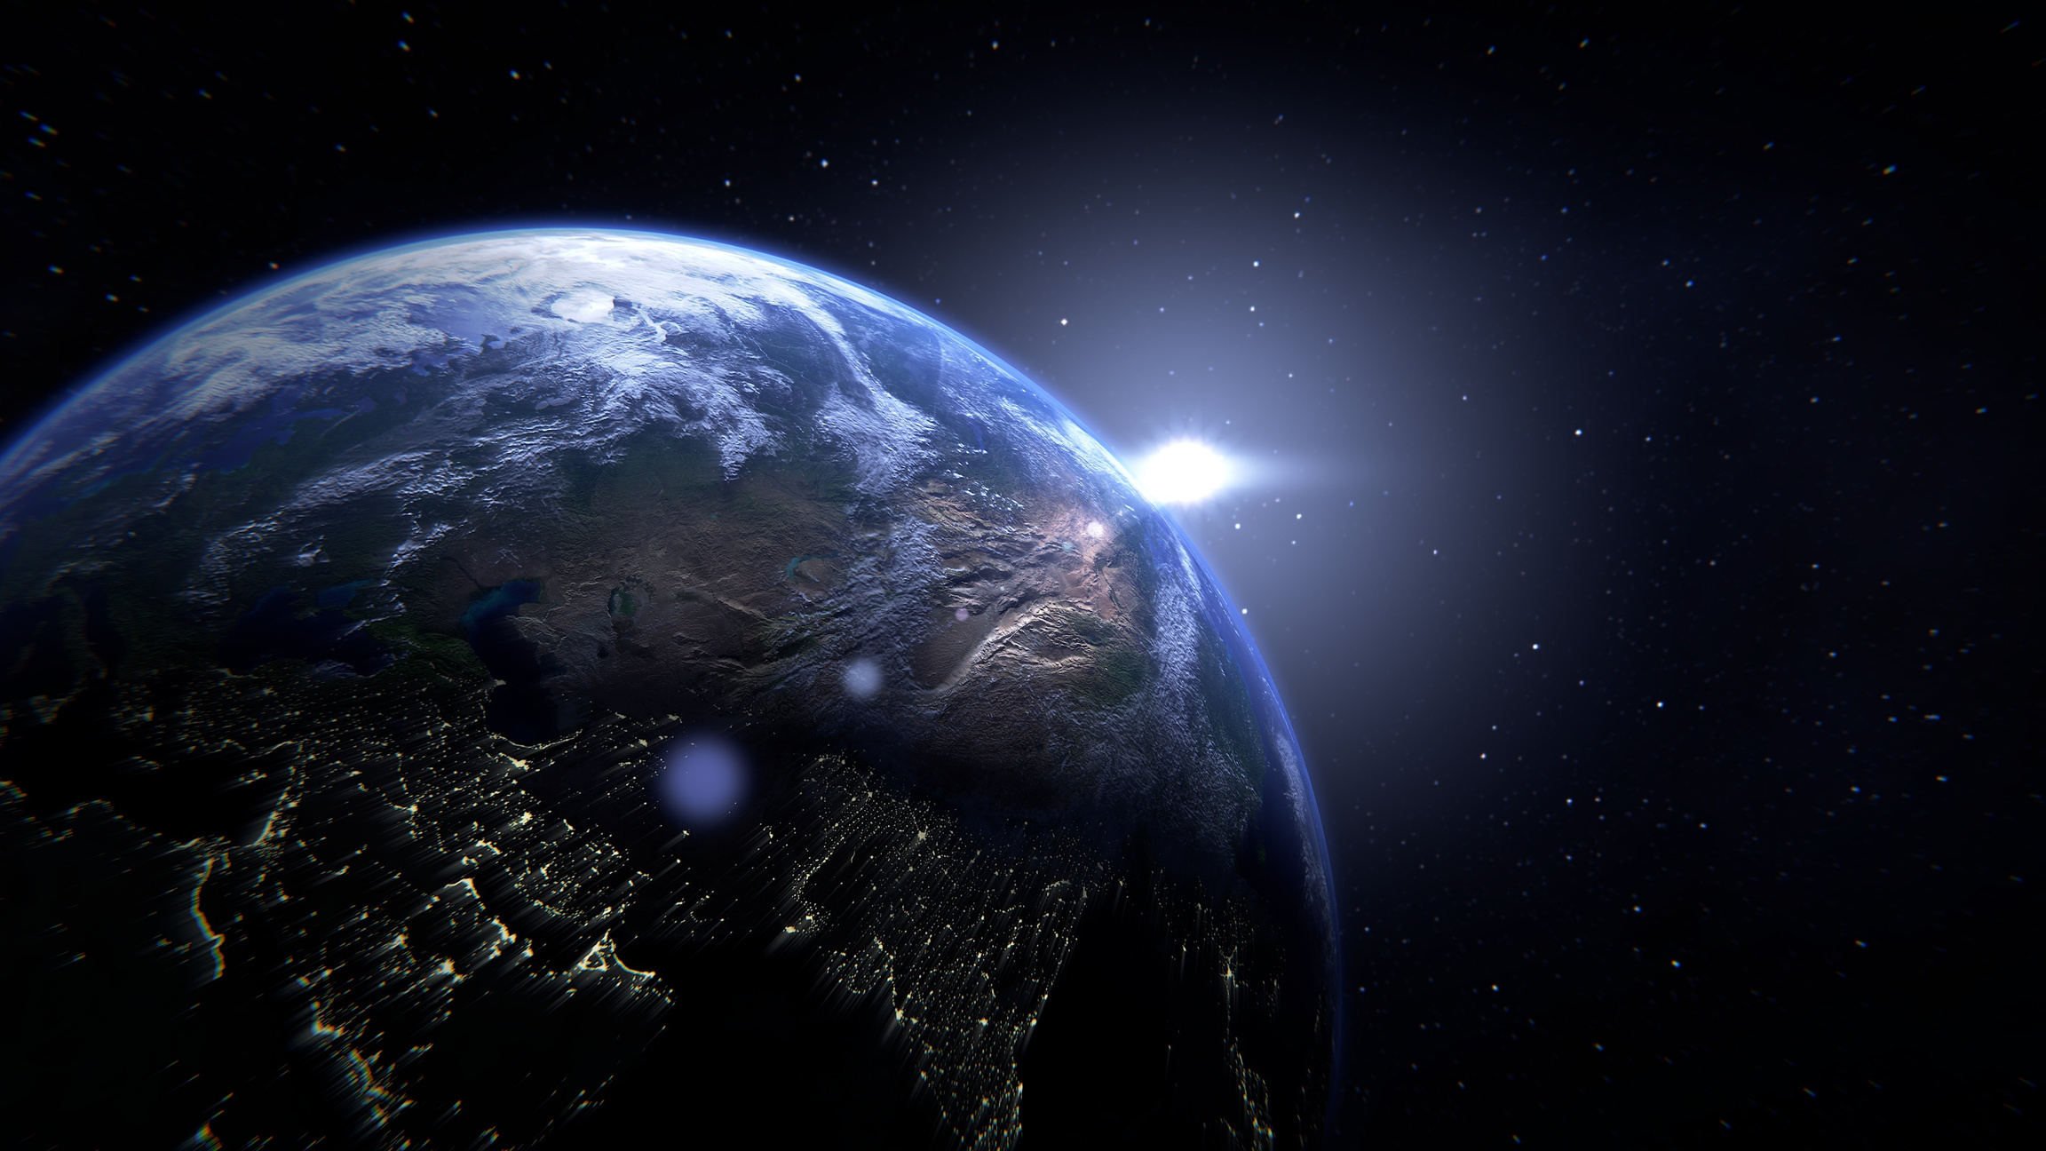




NASA SpaceApps Challenge 2025
Problem
Solution
Approach
Contact
ISSPERIENCE
issperience.netlify.app
davesohamm@gmail.com
All features are working on : issperience.netlify.app

Slide 2

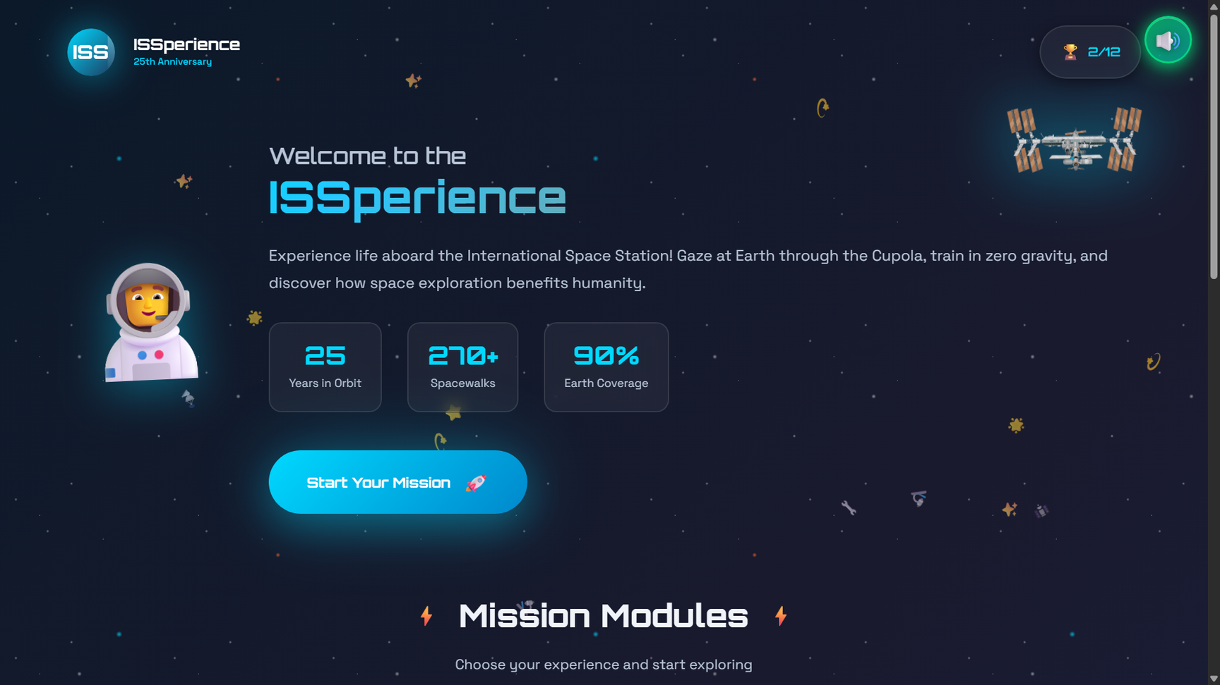
NASA SpaceApps Challenge 2025
Problem
Solution
Approach
Contact
PROBLEM & OPPORTUNITY
Problem
Space education tools are often static; users struggle to grasp life and science aboard the ISS There are not many 3D interactive tools available, that can give knowledge in an interactive and entertaining way.
Opportunity
Modern WebGL runs in the browser to render an interactive Earth and ISS perspectives—no installs, instant engagement on common school device. Open datasets and publicly available imagery can power live or recent Earth views, events, and overlays that tie learning to the real world.
User Needs
Students : hands-on activities that simulate microgravity constraints and connect observations to real data and missions. Educators : ready-to-run modules that fit a 5–15 minute block, with clear learning objectives and visible progress.
Constraints
Runs fully in the browser with no install, minimal permissions, and privacy-safe defaults; quick start in under 5 minutes. Performs on mid-tier hardware and school networks via progressive loading, lightweight assets, and graceful feature degradation.
Problem Statement : International Space Station 25th Anniversary Apps

Slide 3
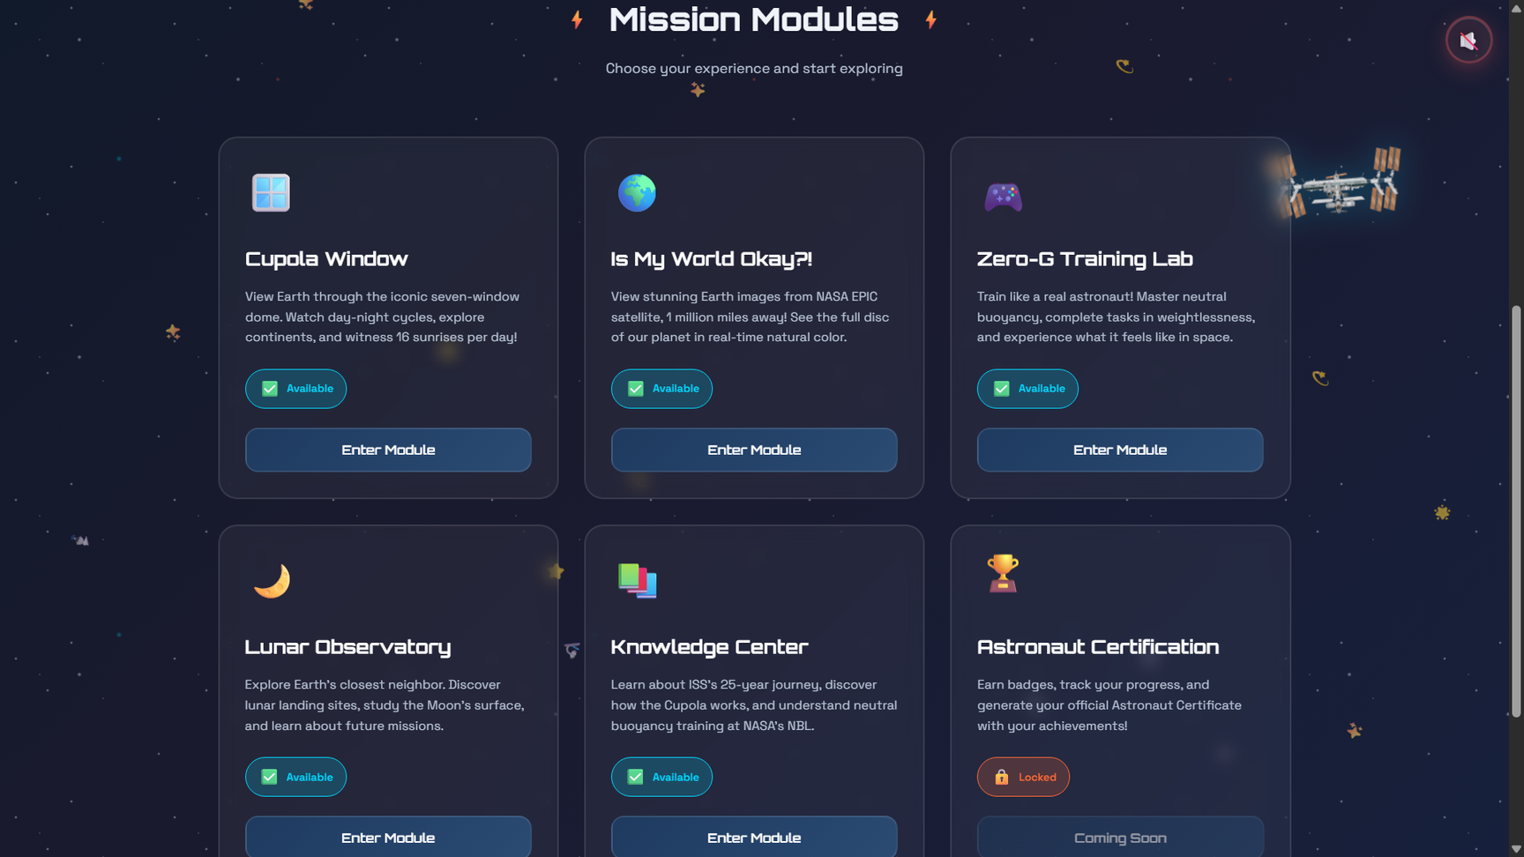
NASA SpaceApps Challenge 2025
Problem
Solution
Approach
Contact
OUR SOLUTION: ISSPERIENCE
Zero‑G Training: Mini‑challenges for movement, tool handling, and hatch navigation that build intuition for safe microgravity motion. Short, timed tasks provide instant feedback to practice inertia and momentum control.
Cupola View: An ISS‑style Earth window with smooth orbital motion, clouds, and the day–night line for astronaut‑level observation. Pan and zoom to spot notable regions and connect visuals to real phenomena.
Earth Check: Interactive 3D globe with layers to reveal real‑world patterns. Simple filters help compare regions, distances, and day/night coverage. Watch an animated earth real-time view!
Lunar Observatory: Guided exploration of Moon phases, landing sites, and missions to compare Earth–Moon perspectives. See the moon from the eyes of Apollo 11.
Knowledge Center: Bite‑sized lessons on ISS life, systems, comms, and NBL basics with quick checks for understanding. Image‑rich cards link to interactive moments for immediate reinforcement, and a quiz!
Astronaut Certificate: Milestone tracking that awards badges and a shareable certificate to motivate completion and mastery. Progress carries across modules for classroom or event showcase.
Common Features: 100% in‑browser, fast start, accessible controls, and engaging audio for 5–15 minute sessions. Optimized for typical school devices with no installs or sign‑ins.
Built concise, continuous lines for each module with an extra sentence to enrich the description without sub-bullets.

Slide 4
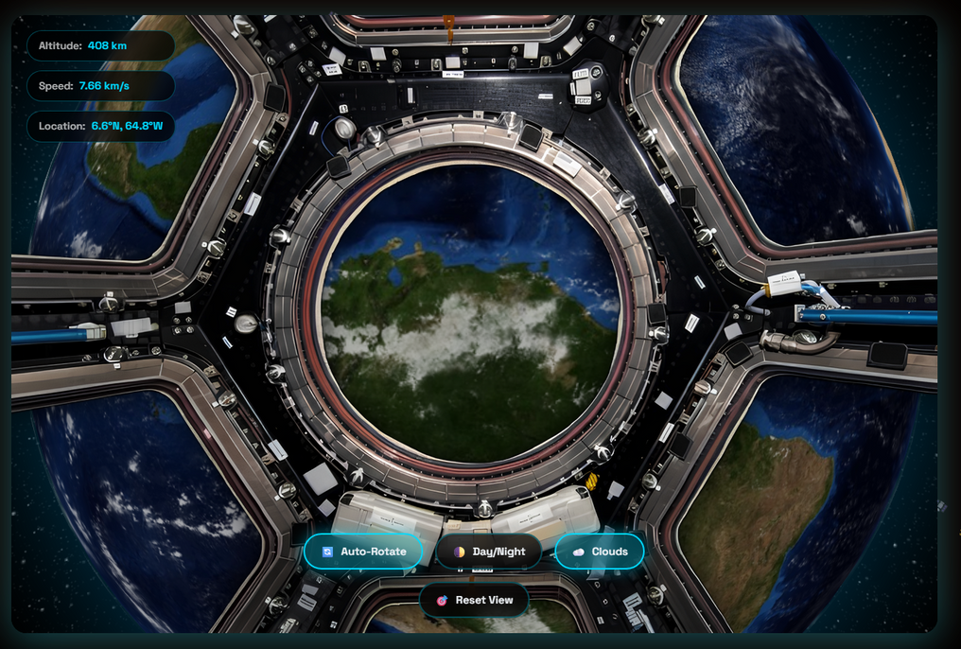
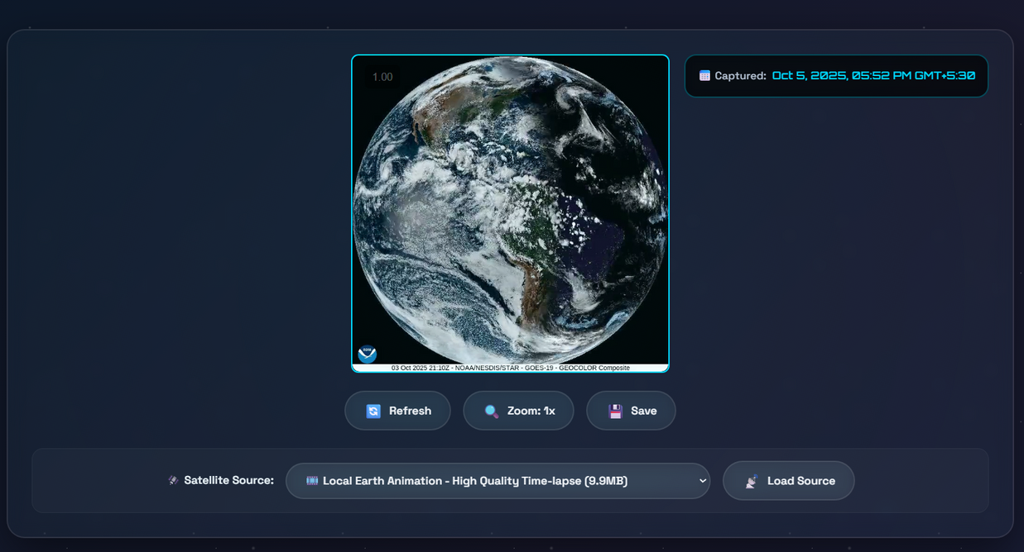
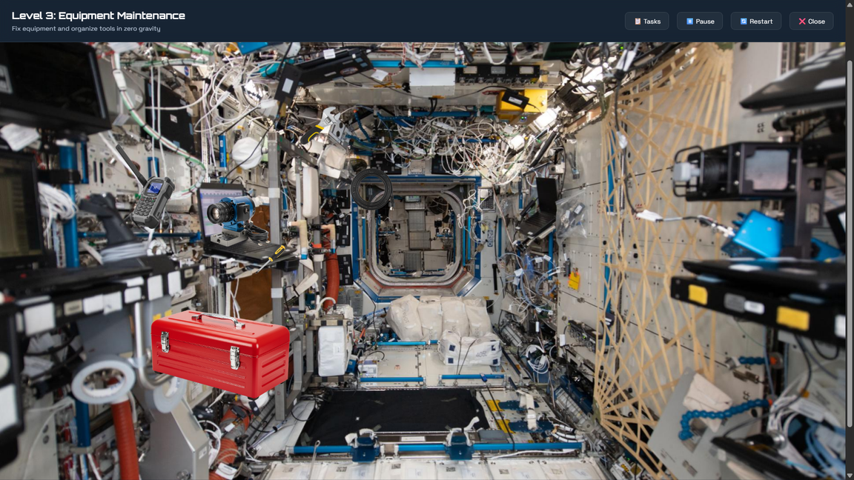
NASA SpaceApps Challenge 2025
Problem
Solution
Approach
Contact
MODULE TOUR
Cupola Window : View Earth through the iconic seven-window dome. Watch day-night cycles, explore continents, and witness 16 sunrises per day!
Is My World Okay ? : View stunning Earth Images using NOAA Satellite. The feed gets updated after every 10 minutes. Try the 40 hours live animation of earth as well.
Zero-G Training Lab : Train like a real astronaut! Master neutral buoyancy, complete tasks in weightlessness, and experience what it feels like in space.
01
02
03

Slide 5
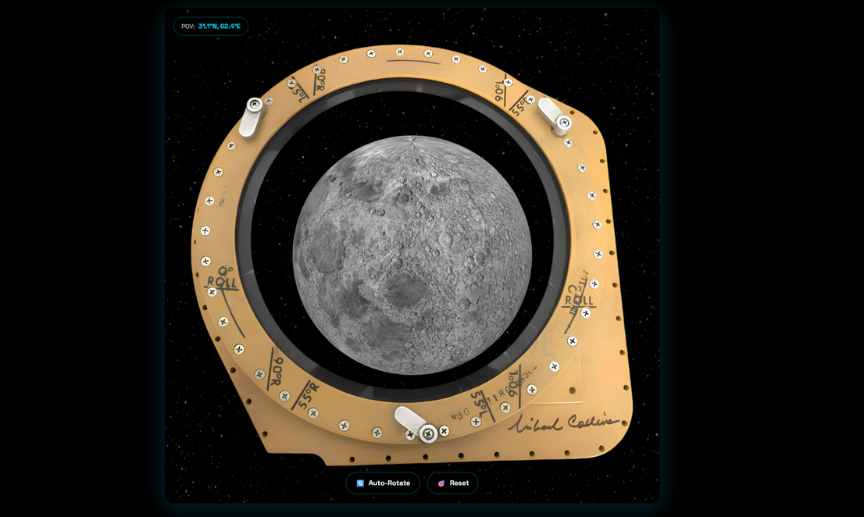
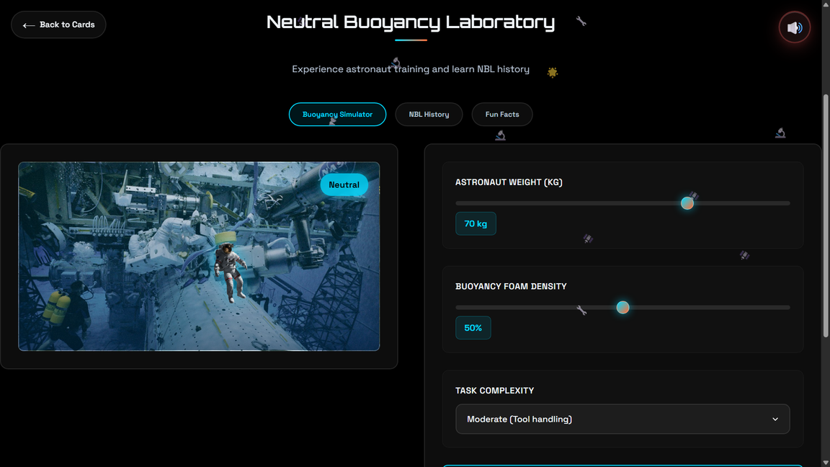
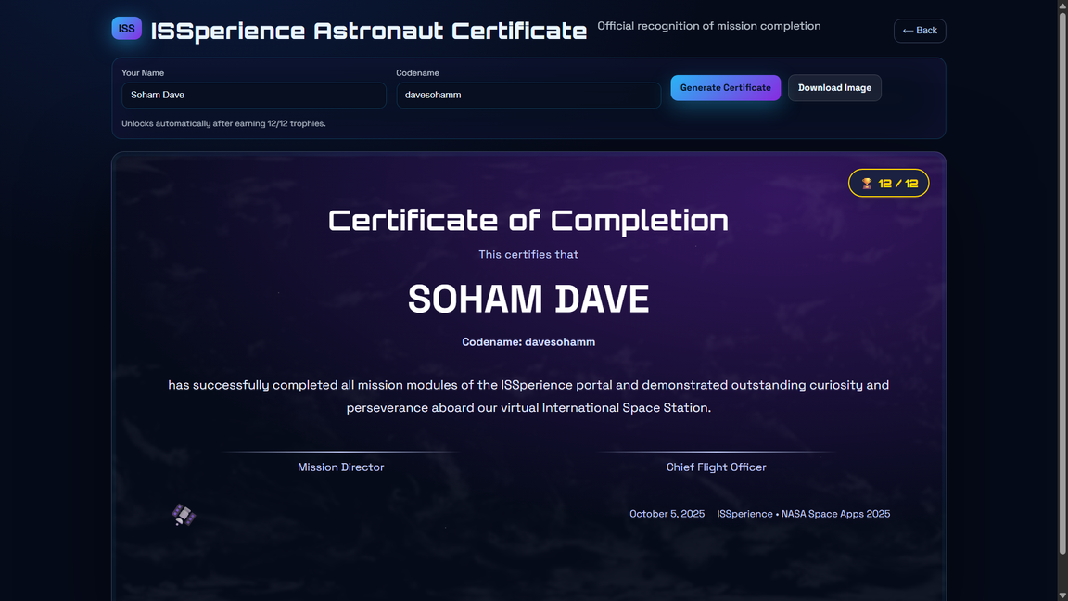
NASA SpaceApps Challenge 2025
Problem
Solution
Approach
Contact
MODULE TOUR
Lunar Observatory : Explore Earth's closest neighbor. Discover lunar landing sites, study the Moon's surface, and learn about future missions.
Knowledge Center : Learn about ISS's 25-year journey, discover how the Cupola works, and understand neutral buoyancy training at NASA's NBL.
Astronaut Certification : Earn badges, track your progress, and generate your official Astronaut Certificate with your achievements!
04
05
06

Slide 6
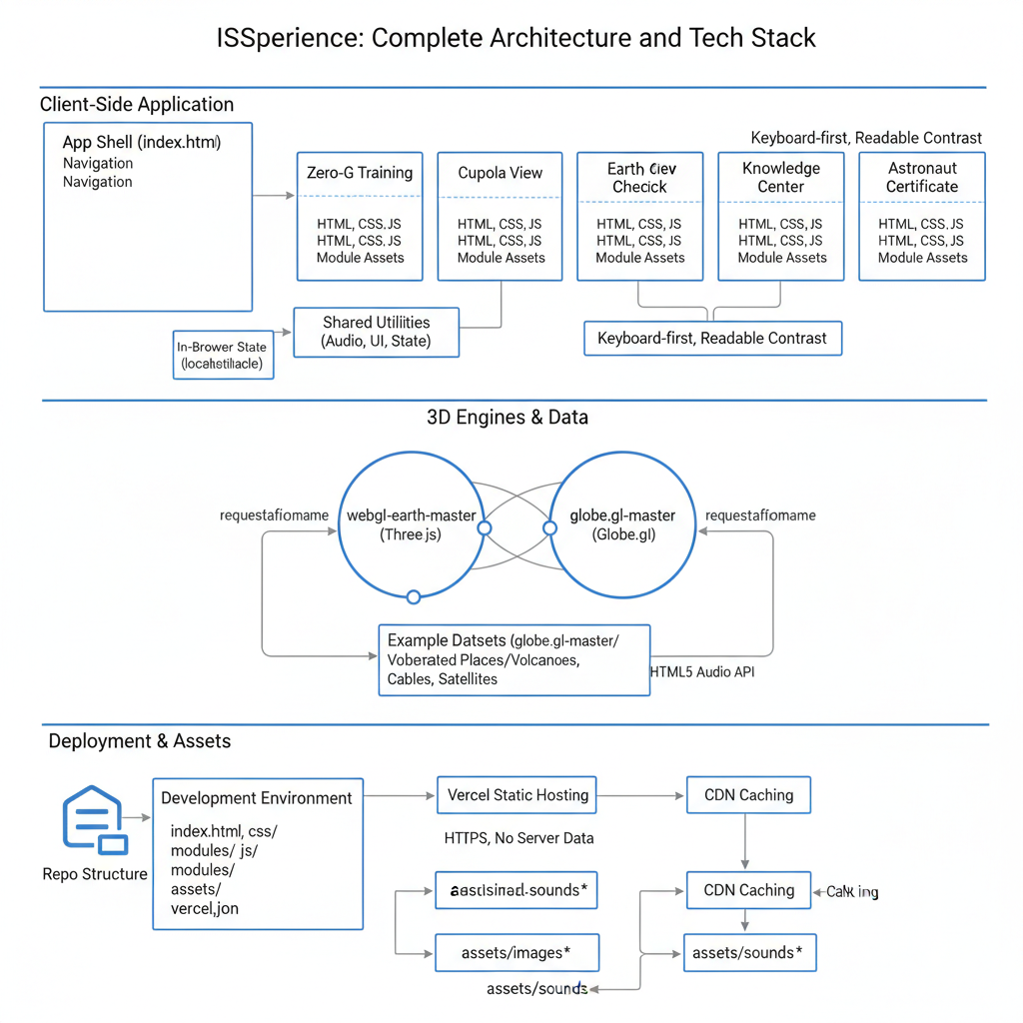
NASA SpaceApps Challenge 2025
Problem
Solution
Approach
Contact
ARCHITECTURE, IMPACT, & STATUS
Architecture : A modular front‑end built with HTML/CSS/JS powers interactive WebGL scenes for Earth and Moon, sharing UI components and a lightweight state layer that persists progress, badges, and settings across modules. Assets are streamed with lazy loading and CDN caching; interactive layers (clouds, solar terminator, markers) use debounced inputs for smooth performance on typical classroom hardware. Accessibility is baked in with keyboard navigation, clear contrast, captions/tooltips, and simple controls suited for mixed‑age audiences.
01
Impact : ISSperience turns passive space content into hands‑on exploration, helping learners internalize microgravity movement, orbital perspectives, and Earth systems through short, goal‑oriented activities. Browser‑based delivery removes installation barriers and enables quick starts in classrooms, museums, and community events worldwide. The combination of real‑world datasets, astronaut‑style views, and achievement cues increases engagement, retention, and shareability of learning outcomes.
02
Status : Core experiences—Zero‑G Training, Cupola View, Earth Check, Knowledge Center, and Astronaut Certificate—are functional and integrated with audio feedback, stable 3D globe rendering, and cohesive navigation. The project is demo‑ready on desktop browsers with polished visuals and reliable performance; content aligns to 5–15 minute learning blocks. Upcoming work focuses on expanded datasets (satellite passes, aurora, weather overlays), enhanced mobile performance, and an educator‑friendly classroom mode with guided flows and simple reporting.
03

Slide 7
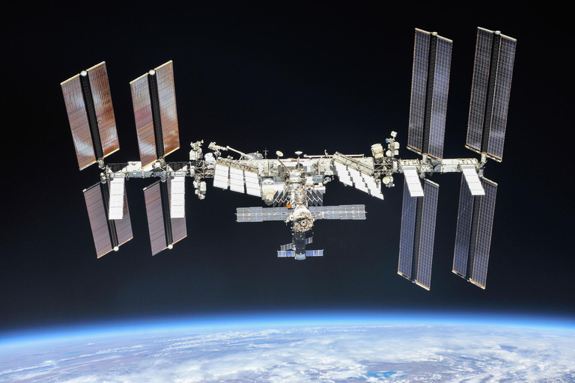
NASA SpaceApps Challenge 2025
Problem
Solution
Approach
Contact
DEPLOYMENT & CONTACT
GitHub Source Code is available on :
https://github.com/davesohamm/NASA-SpaceApps-2025
The ISSperience is LIVE on :
https://issperience.netlify.app/
01
02
Detailed Problem Statement View :
SpaceApps 2025 Portal
You can write me at :
davesohamm@gmail.com
03
04

